Slide 1

v.0.0.1

Slide 2
Using your Web Browser,
Open this URL:
Click on the workshop you’re attending, and find:
1
http://mlhlocal.host/lhd-resources
2
Setup Instructions
The Code Samples
A demo project
A Workshop FAQ
These Workshop Slides
More Learning Resources
Notes:
What to Say:
Tell attendees we are going to check them in for the event
Once attendees check in, they will receive an email with the items listed on the slide
Attendees must check-in to get credit for attending this event
What to Do:
Confirm that everyone has checked in by asking participants to give you a signal when they receive the email.

Slide 3

Our Mission is to Empower Hackers.
65,000+
HACKERS
65,000+
HACKERS
12,000+
PROJECTS CREATED
12,000+
PROJECTS CREATED
400+
CITIES
We hope you learn something awesome today!
Find more resources: http://mlh.io/
Notes:
What to Say:
Major League Hacking (MLH) events are meant to bring hackers together so they can learn, build, and share.
Give participants a brief overview of Major League Hacking (MLH).
Tell participants they can learn more at http://mlh.io/
Example Talking Points:
TODO
Through Localhost MLH is rethinking technology education to reflect how hackers actually learn and how fast the industry moves.
Here's some quick facts about MLH:
Each year, MLH supports over 65,000 hackers around the world at events they facilitate
Those students create more than 12,000 amazing projects together
MLH is a global organization that empowers hackers in more than 400 cities and growing every day

Slide 4
What will you learn today?
1
What you can build with Unity
2
How to build Unity projects
3
How to use Unity
4
The basics of C#
Notes:
What to Say:
Explain to participants what they will learn today
Learning is a core part of being a hacker and today they are going to learn something new
What to Do:
Get participants excited about the experience.

Slide 6

What is
Unity is a powerful development tool for building 2D and 3D games for over 25 different platforms.
It provides a robust, real-time engine used to create fantastic, popular games on many platforms, especially mobile platforms and VR/AR experiences.
It is also a complete development environment that uses the C# language for development!

Slide 7

Awesome Unity Projects
Unity is used to produce amazing games and short films.
http://mlhlocal.host/unity-examples
FAR: Lone Sails in this video is a student made game.

Slide 8

What are you going to do with Unity?
http://mlhlocal.host/unity-demo
You're going to write some of the code for this awesome racing game. Navigate to the URL above to test the game!

Slide 9
Well that was cool! Let's see what we need to do to be able to build this game!
Please note - there are many set up steps. When you're finished, you will be all set up to develop with Unity!

Slide 10

What do I need to create with Unity?
To complete this workshop, you need the following tools and technical specifications:
Unity version 2018.1.1 (this version is required, please don't use any other version)
15GB of storage available
Admin access to the computer you're using, especially the password
The text editor of your choice.

Slide 11
How are you going to do this?
To build games with Unity, you need several applications on your computer.
The project folder - you either need to download this from mlhlocal.host/unity-project or copy it from one of the flash drives provided
Unity Hub - download from mlhlocal.host/unity-hub or copy from the flash drive
The Unity Editor - download version 2018.1.1 from mlhlocal.host/unity-versions or copy from the flash drive
The text editor of your choice (more on the next slide).

Slide 12

A Note About Text Editors:
You can use any text editor you like, but we recommend Visual Studio Code.
http://mlhlocal.host/vscode
When you install Unity, it will ask if you want to install Visual Studio. Select NO - this is NOT the same thing as Visual Studio Code!

Slide 13

WHOA THERE!
DELETE THIS SLIDE BEFORE PRESENTING
USB Flash Drives: If you received USB Flash Drives, attendees can copy the sample code and install files from there.
Web / Download: If you did not receive USB Flash Drives, attendees will need to download the sample code and install files from the web.

Slide 14
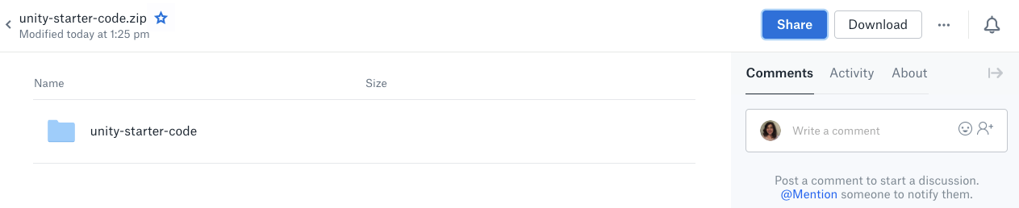
Downloading the Project Files
http://mlhlocal.host/unity-project
Navigate to the URL above to download the project! Note - it might take a long time to download. It's a huge file!
The next slides will tell you how to open the file.

Slide 15
The next slides have instructions for unzipping the file. Please note that a tool like WinRAR or 7Zip (free) will be much faster than the built-in archive tool for Windows.

Slide 16
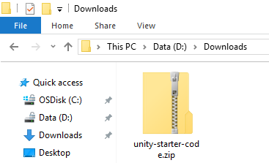
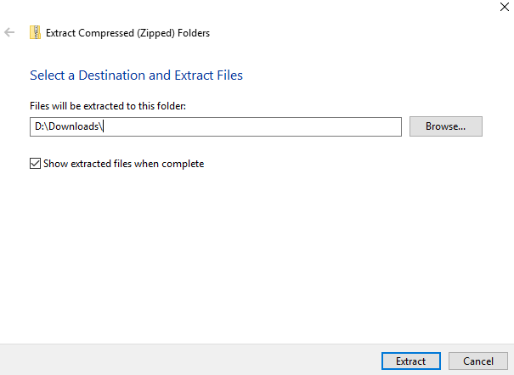
Windows Extraction
(WinRAR or 7Zip Recommended for Speed)
Open your Downloads folder.
Right click unity-starter-code.
Click Extract All.
Delete unity-starter-code from the end of the file name.
Click Extract.

Slide 17
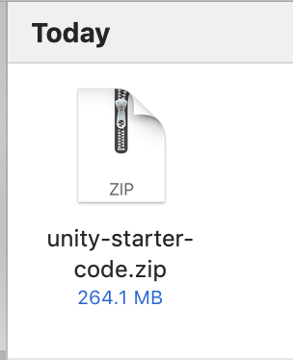
Mac Extraction
Open your downloads folder.
Double click the zip file. It will unzip automatically.

Slide 18
Let's get started!

Slide 20

Downloading Unity Hub
http://mlhlocal.host/unity-hub
Navigate to the URL above.
Select Try Personal.

Slide 21
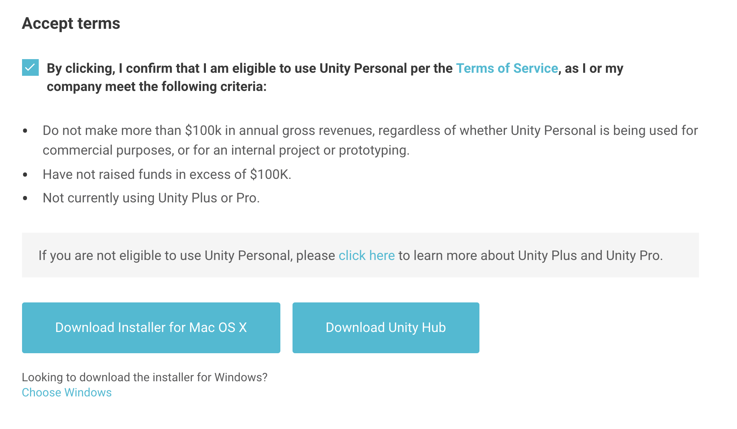
Downloading Unity Hub
Accept the terms.
Select Download Unity Hub.

Slide 22
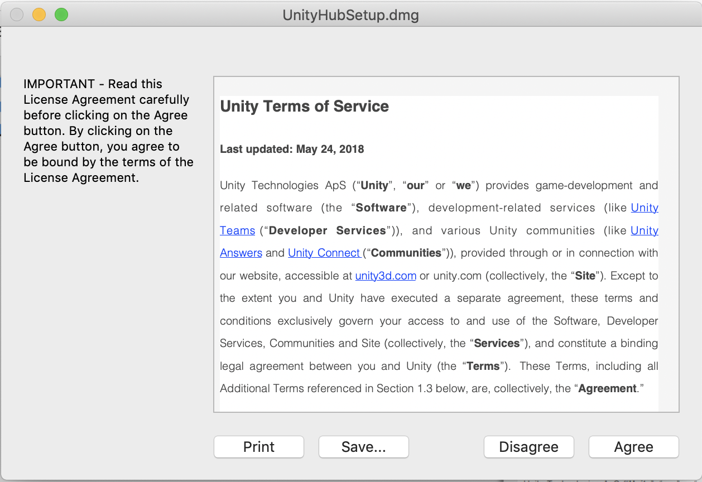
Installing Unity Hub
Open the installer.
Running the installation will require you to agree to the Unity terms of service.
Once you've installed it, we can open up Unity Hub!

Slide 23
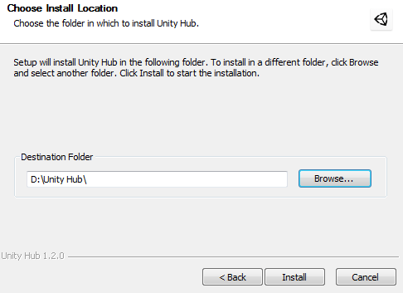
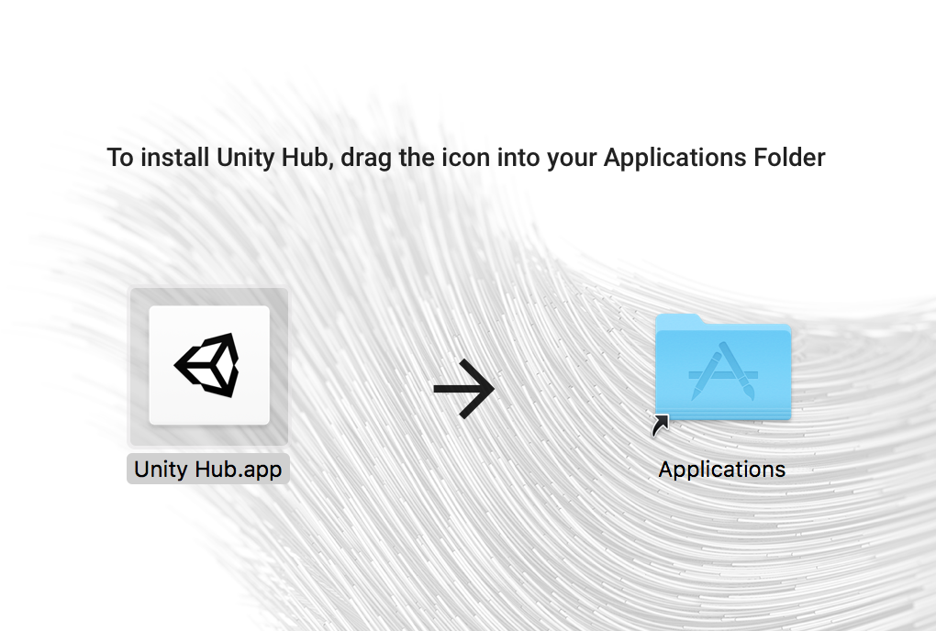
Installing Unity Hub
The Windows installation will provide the option for selecting what disk drive you want the installation to be on. You can simply use the location it recommends.
The OS X installation will require you to drag the Unity Hub.app icon into the Applications folder

Slide 24
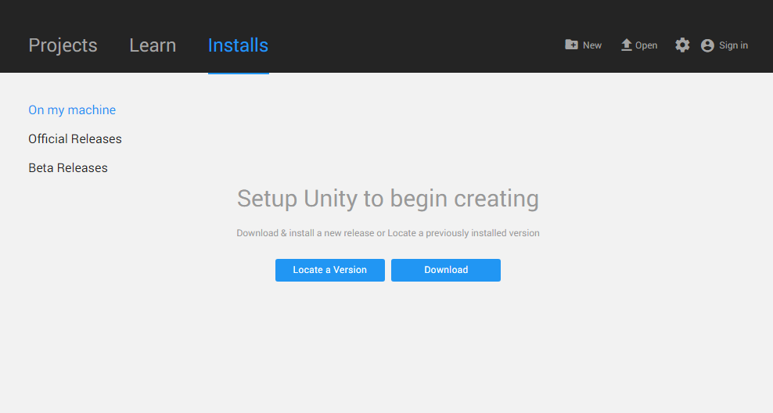
Successful Installation
After a few minutes of installing, Unity Hub should now be installed on our system. Both Windows and OS X installers should open Unity Hub after a successful installation. If not, open it up!
Let’s create a User ID and get to know the interface before we move on.

Slide 25
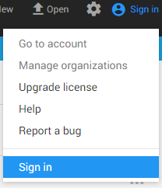

Creating a User ID
To create an ID we need to navigate to the Sign in menu, in the top right corner of Unity Hub.
When the Sign in window appears, we can click ‘Create One’ which will open up an account creation form.

Slide 26
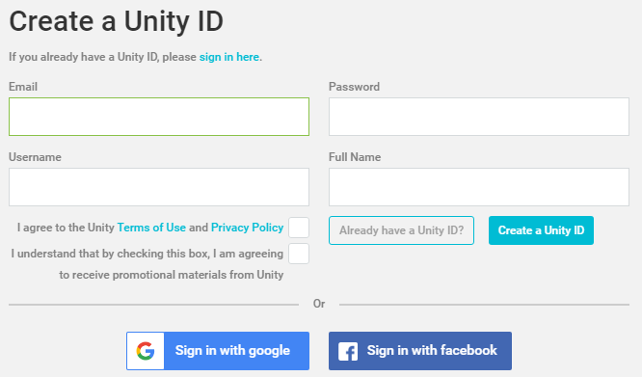
Creating a User ID
Follow the prompts and fill in the form to create your Unity Account.
If you choose to use Facebook or Google Accounts to establish a Unity Account, a separate Log in screen for either service will load within Unity Hub.

Slide 27
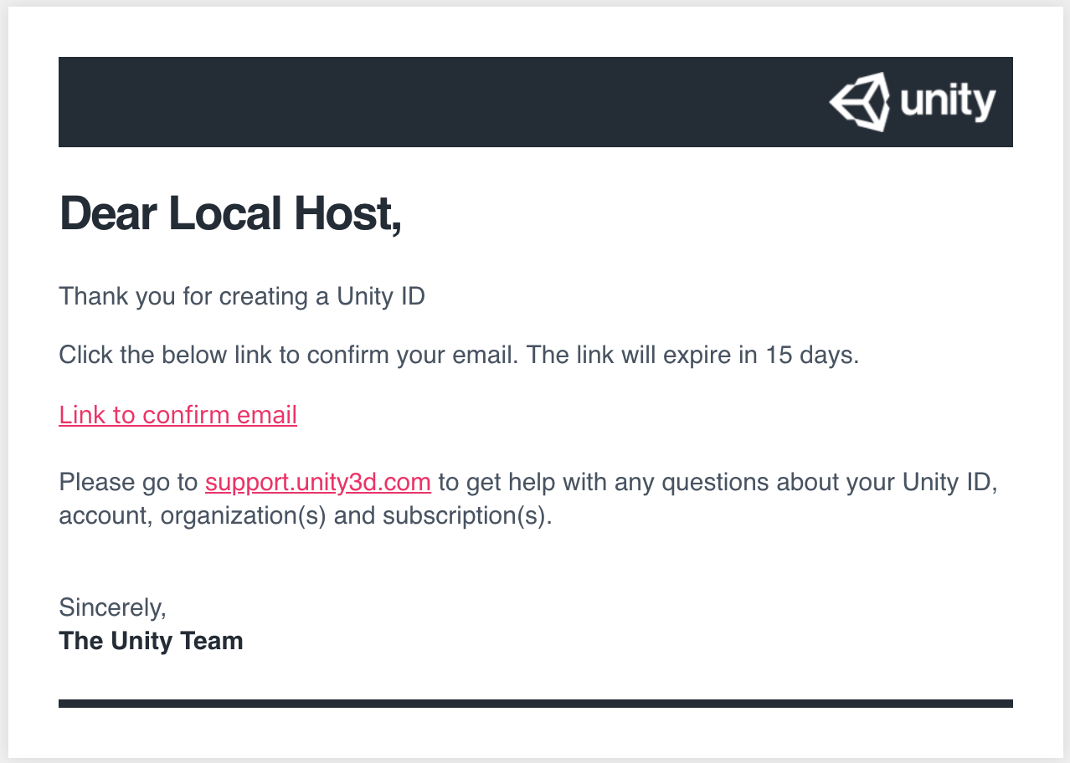
Creating a User ID
If you sign up with an email, you will need to confirm your email address.
Click the confirmation link sent to the email you provided.

Slide 28
Great! You've got Unity Hub installed. Let's get familiar!

Slide 29
Unity Hub UI
From the Hub UI these are all the different things we have access to:
Top left menu
Here we can access all of our Unity installs (the versions of Unity we have on our computer) under the Installs tab
We can access all of our ongoing Unity projects within the Projects tab
And within the Learn tab we can find Unity tutorials and resources

Slide 30
Unity Hub UI
Unity Hub Content
This area displays the Unity Hub content. Content from the Projects, Learn, and Installs tab are displayed here.

Slide 31
Unity Hub UI
Top right menu
Users can access the Sign in tab so they can sign into Unity accounts, report program bugs or access the help menu.
Open tab provides the ability to open pre-existing Unity projects.
The New tab opens the menu to launch new projects within Unity.

Slide 32
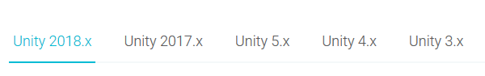
Installing Unity
http://mlhlocal.host/unity-versions
We are able to download Unity 2018 (2018 1.1f1) through the Unity Download Archive.
We require this version of Unity to run the project we’re working with.
Navigate to the URL above and select the following:

Slide 33
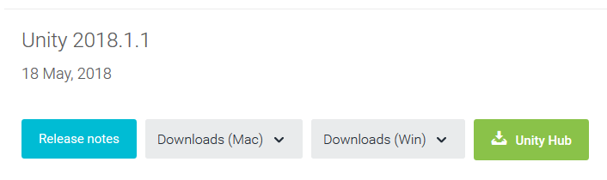
Installing Unity
The version required is 2018.1.1.
Scroll all the way to the bottom to find it.
We have two options available for downloading and installing Unity.

Slide 34
Installing Unity
Unity can be downloaded directly to your machine with either the Downloads(Mac) or Downloads(Win) buttons.
This will download the Unity Install Assistant and guide you through the installation process.

Slide 35
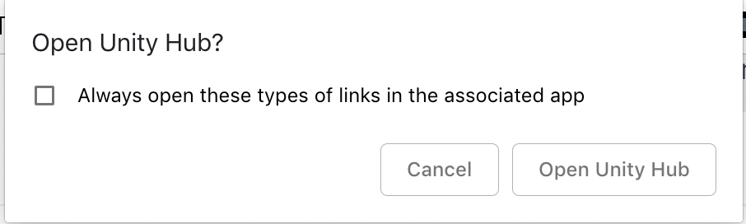
Installing Unity
It's also possible to download this version of Unity through Unity Hub by using the Unity Hub button.
This will open up the version we need, within our Unity Hub desktop application.

Slide 36
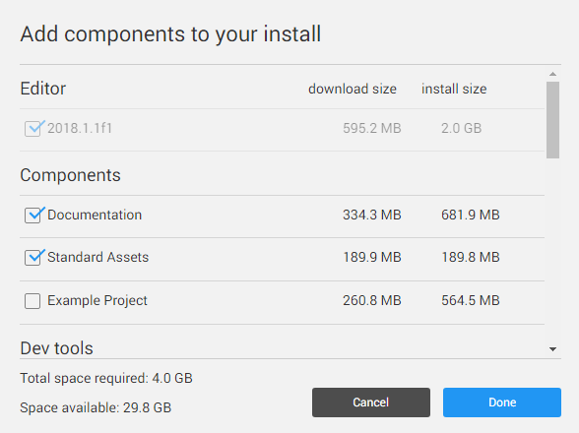
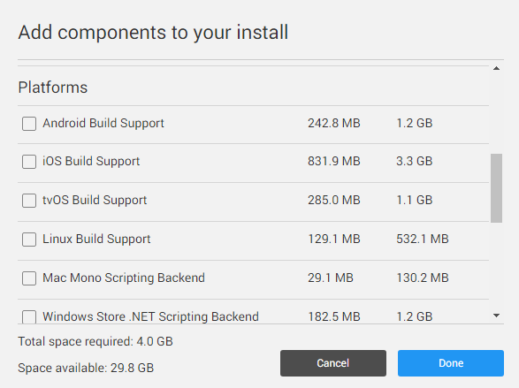
Installing Unity
You'll see a checklist for selecting components within the installation.
We only want to select
Unity Editor
Standard Assets
Documentation
Extra components increase the download dramatically, but they can always be downloaded later with the Unity installer.

Slide 37
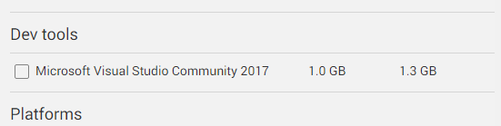
Installing Unity
The Unity installer gives the option to select Microsoft Visual Studio Community as an editor for writing C#.
Despite many Unity developers using Visual Studio to write their code, we will not be downloading it.
We are going to set a code text editor as the default, once we have installed Unity completely.
VSCode is lighter and smaller to download. Once you are familiar with Unity you can use any editor you prefer, that supports C#!

Slide 38

And We’re Off!
You should now be able to find your newly installed version of Unity inside Unity Hub !
Now we can get to know C# and explore Unity!

Slide 40
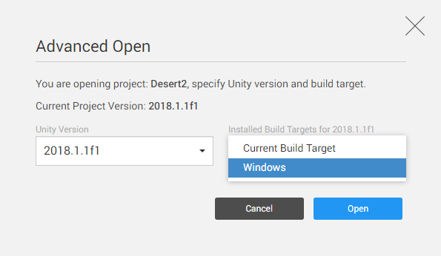
Now, we’re ready to import
From Unity Hub, we can import our project to Unity. It will then load and compile everything required.
The Open tab will let you select a folder to load.
If you’re on Windows you will need the WindowsStandaloneSupport selected in the Installed Build Targets.
On a Mac you will need the MacStandaloneSupport selected in the Installed Build Targets.

Slide 41
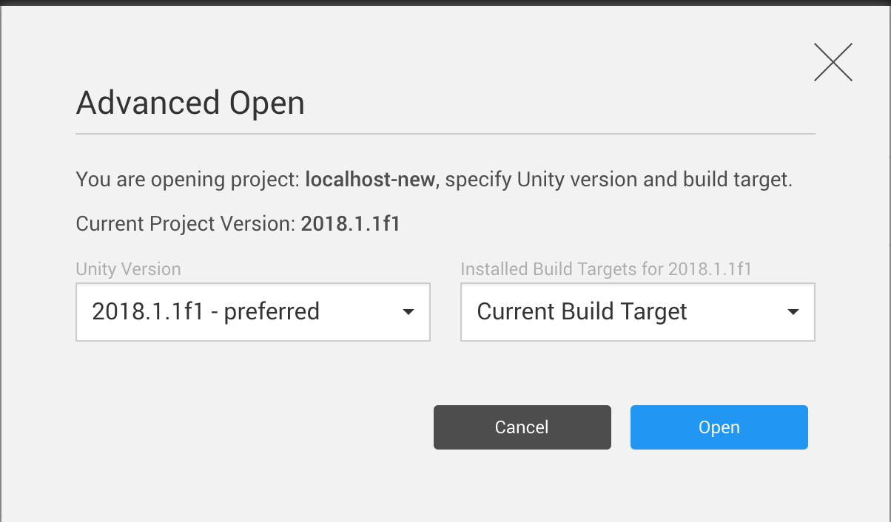
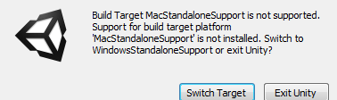
Now, we’re ready to import
Once the folders and Build Target are chosen, let’s click Open and load the game!
If you didn’t change your Build Target you may receive this notification when you open the game in Unity. Selecting Switch Target will help Unity switch for you.

Slide 42
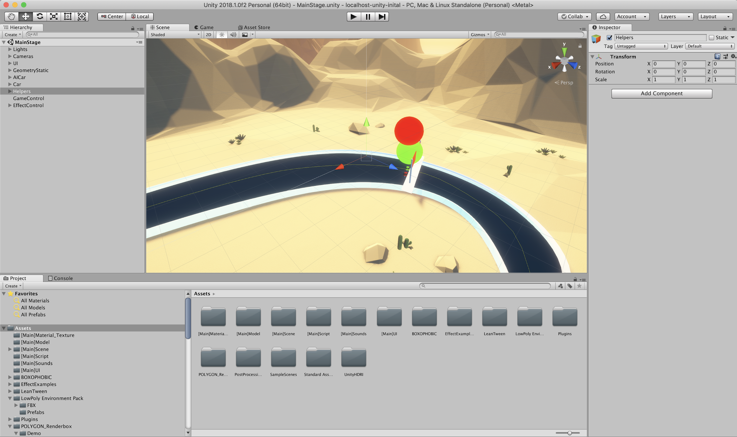
What are you looking at?
You opened Unity, and there is a LOT going on. Let's dive in!

Slide 43
Let’s get to know Unity!

Slide 44
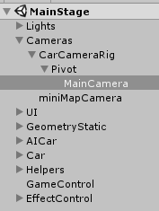
The Scene Hierarchy
The project we opened in Unity is packed full of content and the Hierarchy window is able to show us everything that is in the current scene.
We can navigate the files to see all of this.
By selecting an asset within the Hierarchy window, we can find and select objects live in the scene window.
Try selecting the MainCamera object
Cameras>CarCameraRig>Pivot>MainCamera

Slide 45
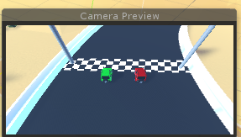
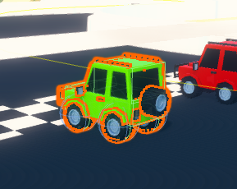
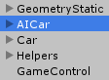
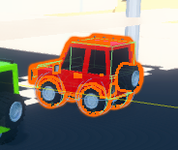
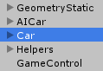
The Scene Hierarchy
If we select the MainCamera in the Hierarchy window, we are provided with a preview of the camera objects initial view. It shows the view of our Camera object in the scene.
Now, try selecting the Car object
If we choose another asset, such as the Car or AICar, we can see the objects become the area of focus and become outlined within the scene window.

Slide 46
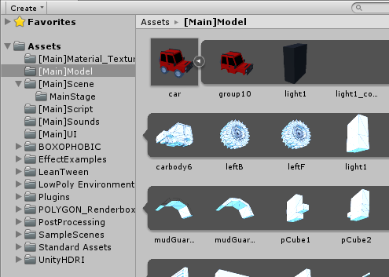
The Project Window
The Project window provides a list of every single item within our Unity project.
We can use this to open Scripts, find assets to add into scenes and locate anything else incorporated in our project.
The Project window provides several abilities such favoriting items, and a text search field. These make it faster to find items or relocate frequently used content.

Slide 47
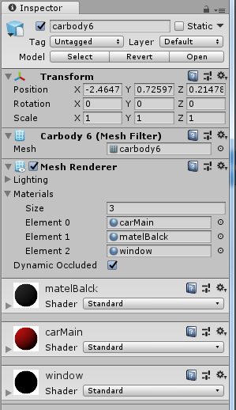
Inspector Window
Any time we select an object in our Scene window, you might notice the Inspector window changes too.
It loads up important details about whichever object we have selected at the time.
If we select objects in the Scene window, Hierarchy window or Project window, the details will still display within the Inspector view.
Within the Inspector, we can apply, remove and control the Components we apply to game objects. We will explore Components more later!

Slide 48
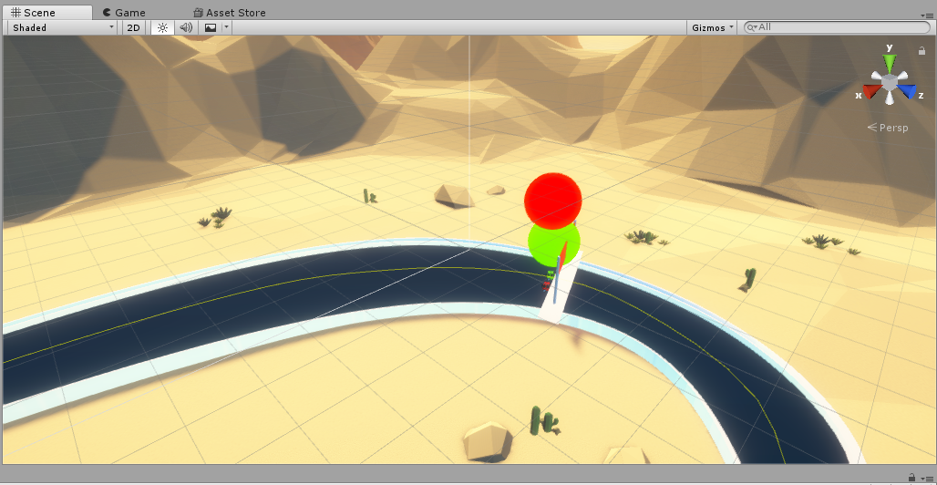
Scene Window
The Scene Window is our interactive view into the world being created.
It’s here we can add, remove and manipulate models, scenery and any other type of asset you have in the scene!
Knowing how to control game objects inside a scene is an essential skill in Unity.

Slide 49
The 3D World
Unity might still look confusing, but we won't be using every tool available. Let's try moving your field of view around the 3D world! Some common interactions:
Right click + drag = Camera pivot
Middle mouse click + drag = X-axis movement
Scroll wheel = Jumping Zoom in / Zoom out
Hold ALT + Right click + pan left and right = Constant Zoom

Slide 50
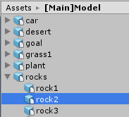
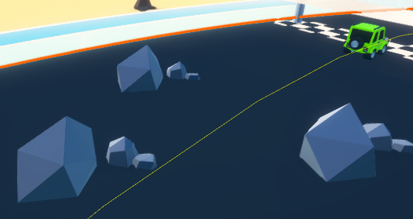
The 3D World
We can drag 3D Assets directly into the scene to create content! Unity provides numerous built-in assets for your project!
In our Project tab, let’s navigate to an asset we already have. Select: Assets > Model > Rocks > Rock1
Then drag that file into our scene, and a new 3D object will appear! It’s really that simple.

Slide 51
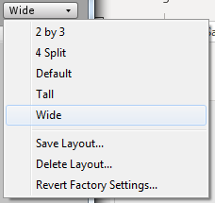
User Interface Layout
The Unity UI has many items and menus, we might find ourselves repositioning them to get a better view of other areas.
In the top right corner of Unity, a drop down menu provides several layout configurations.
These will reposition the entire Unity Editor layout!
Select one and see. The changes will happen instantly.

Slide 52
User Interface Layout
If you customise the area sizes in Unity to your liking, you can save it as a permanent layout to choose later using Save Layout… .
You can also delete it with Delete Layout…
If the windows are ever lost or moved around too much and become confusing to locate, clicking default will take you back the initial Unity display.

Slide 53
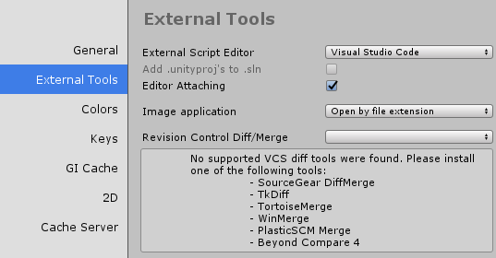
Let’s set your Editor!
To edit code with Unity, a text editor or IDE is essential.
Let's set our preference now by selecting Unity on Mac or Edit on Pc then:
Preferences > External Tools > External Script Editor, then choosing your preferred text editor.

Slide 54
Great! Let's get to work with this project.

Slide 55
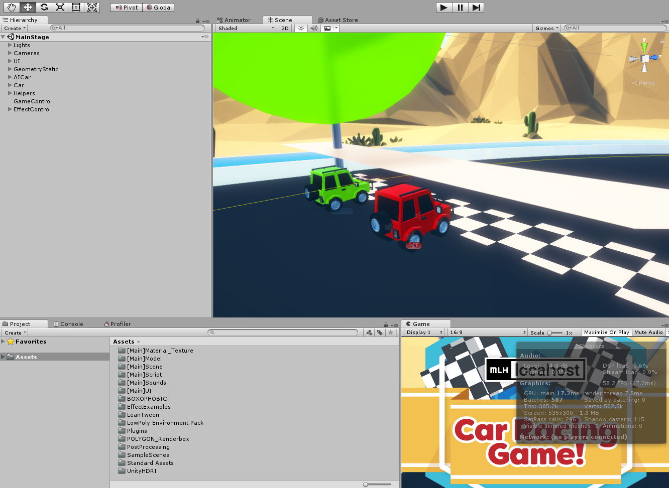
Car Racing Game
The project we uploaded is a car racing game. Here are some features already built in:
Player VS AI
Keyboard input controls
Collision detection
Interactive Menu

Slide 56
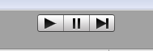
Let’s Test This Out!
To see how the game runs, control buttons are at the top of the application.
Play the game
Step through the game by executing 1 frame every click
Pause the game

Slide 57
Whoa what’s wrong?
A few parts of the app aren't working properly. You're going to fix them!
Problem I:
You can't move your car. Why is that?

Slide 59
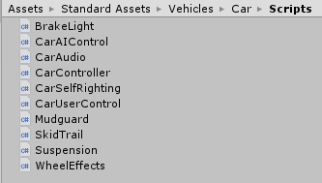
CarUserControl.CS
There is a file called CarUserControl.cs. Let's open that up.
In the Project tab we can follow the path:
Standard Assets > Vehicles > Car > Scripts > CarUserControl.CS
Double click the file to open it in the editor you set previously.

Slide 60
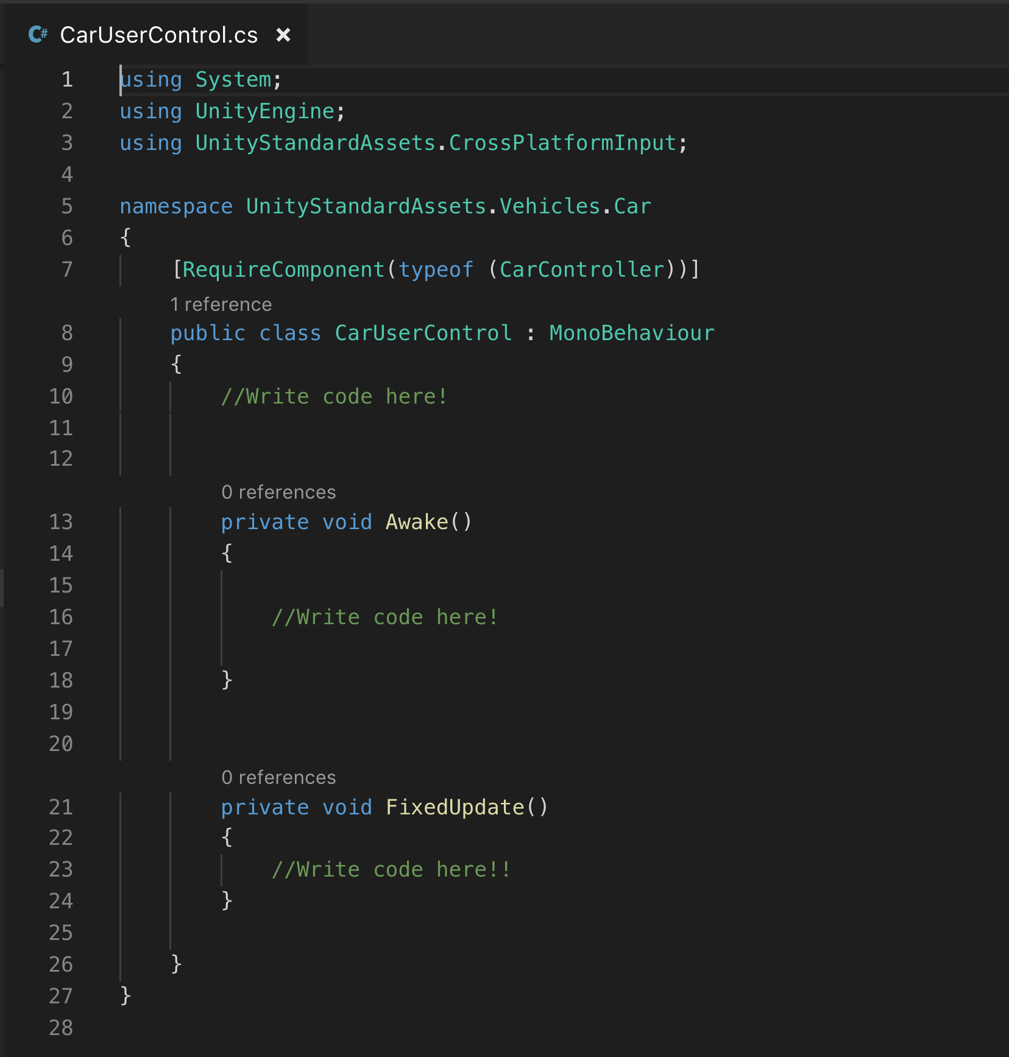
Missing Code
Well, that doesn't look right. This script is practically empty! It should allow the user to control their car with the W A S D or arrow keys.
With missing code the game no longer has controls, and can not be played.
We are going to repair this script, step by step with C#.

Slide 61

The C# Language
C# was created by Microsoft around the year 2000.
It's a multi-paradigm, general purpose programming language.
It is an extremely popular language supported within the Unity environment.

Slide 62
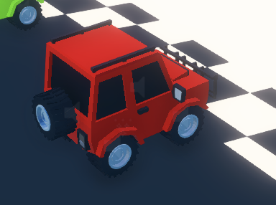
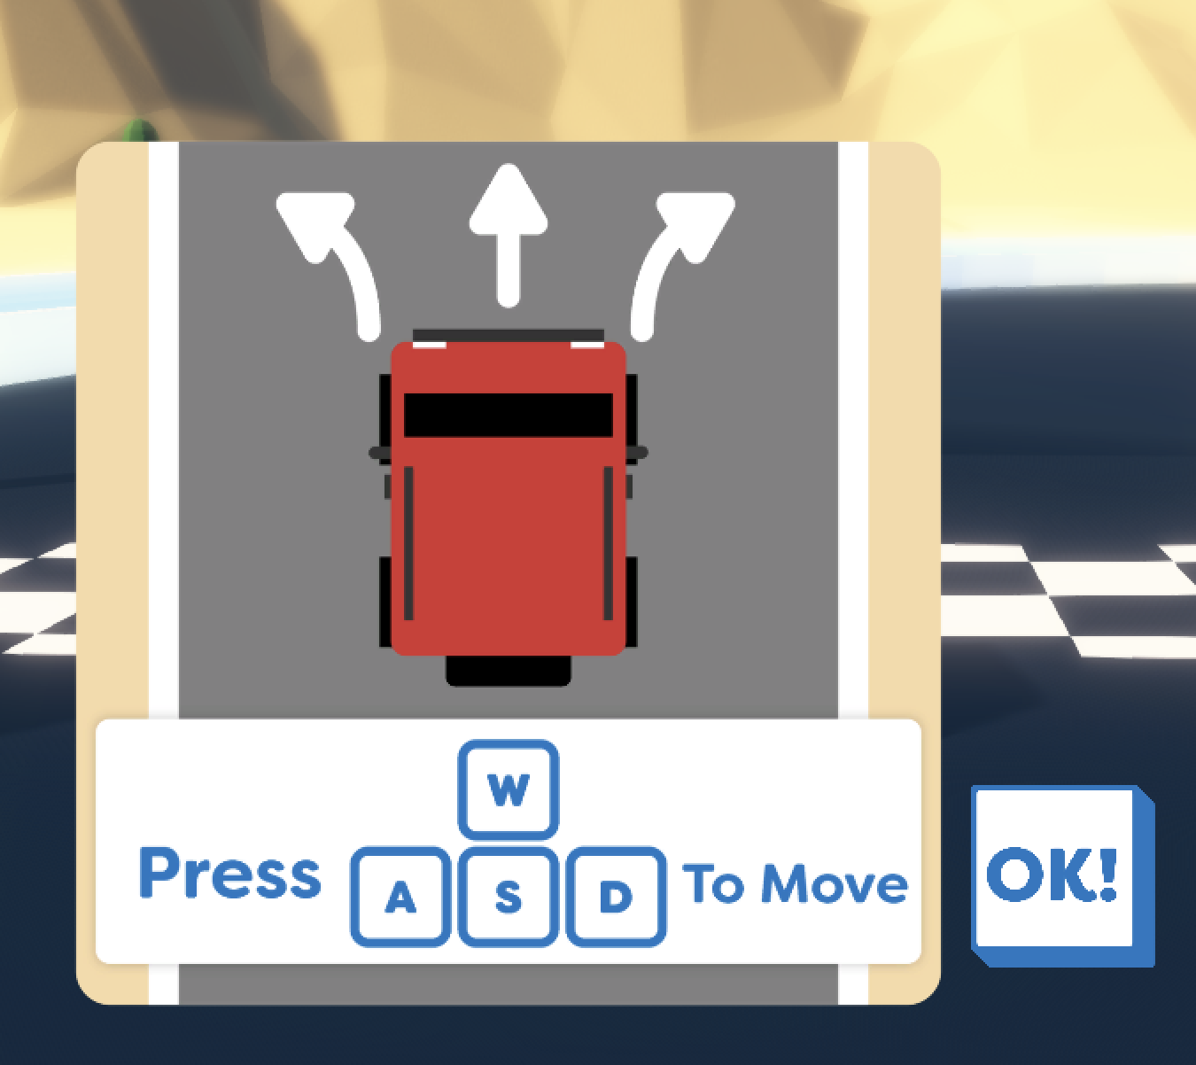
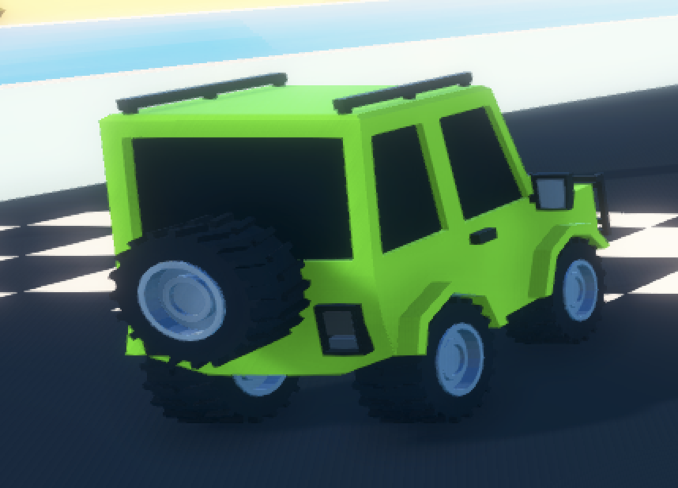
C# in Unity
C# is not written in the same format inside Unity, compared to a stand alone C# application.
Unity allows developers to write individual scripts to control objects in the game environment.
Objects are items within the game, such as 3D models or a light source etc.

Slide 63
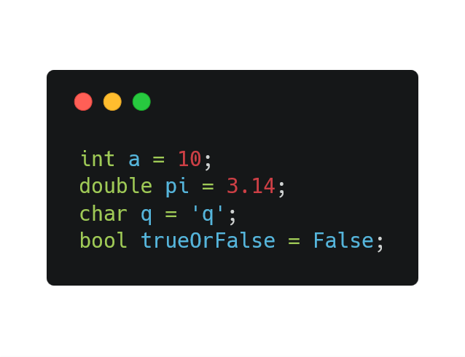
C# Variables
Variables hold data in a computer program and allow you to access them.
With C# we are able to declare, access and manipulate variables.
In C# they need to be declared as a specific type to determine what values that can contain.
C# variable declaration follows a simple structure:
<variable_type> <variable_name> = <value>

Slide 64
C# Functions
C# Functions are more formally known as Methods.
Functions make it possible to write code within a certain scope in any Class or file, but execute it anywhere in the applications code.
Functions in C# have a certain structure they follow when being written.
Functions in C# have a very similar look and feel to Functions in Java or C
<Access Specifier> <Return Type> <Method Name> (Parameter Type ; Parameter)

Slide 65
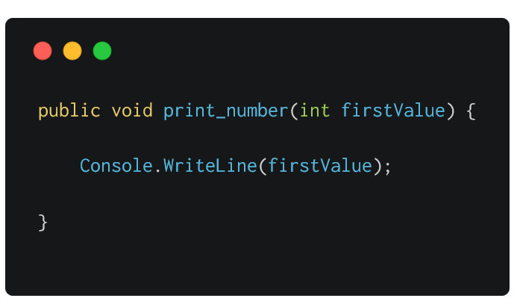
C# Function Structure
Access specifiers determine the scope of where a function can be accessed.
Public allows the function to be accessed anywhere outside of the Class.
Private prevents the function from being accessed outside the Class it's declared in.
Protected is similar to Private, but grants access to subclasses

Slide 66
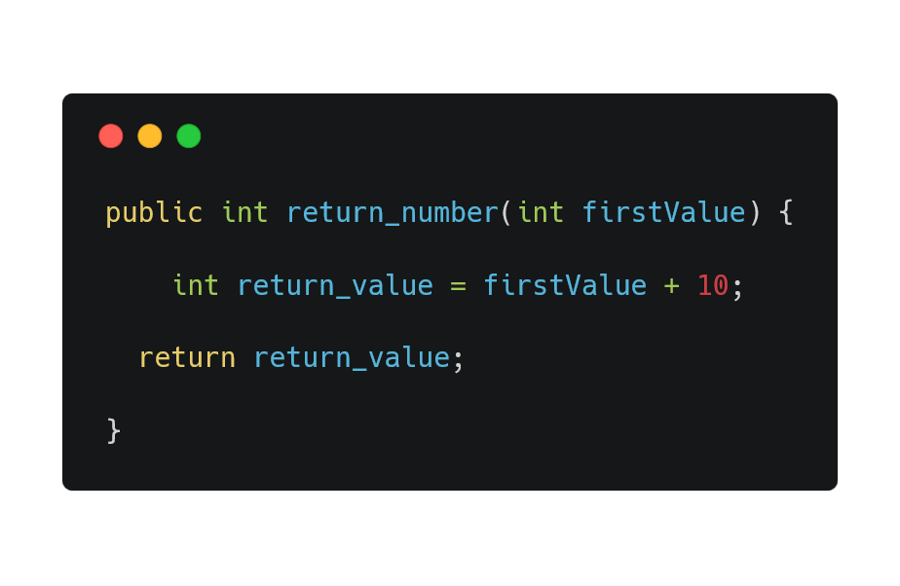
C# Function Structure
Return Types are the value types the function will return.
Void means a function has no return type, it will not be required to return a value at the end of its execution.
Returning data types with values, such as an Int or Boolean will require the function to perform an action in the code body that returns a value of the specified type.

Slide 67
C# Function Structure
Function Names are needed to define functions.
They are used to call and execute functions from different locations in our code.
A benefit to well thought out Function Names is that they can allow a user to know what a function does without reading the body of code that it executes.

Slide 68
C# Function Structure
Parameters provide the ability to pass values to functions.
Parameters let you set what values and data types are able to be passed and accessed by the function.
Having fixed Parameters also makes it simple to determine how many are able to be passed to a function.

Slide 69
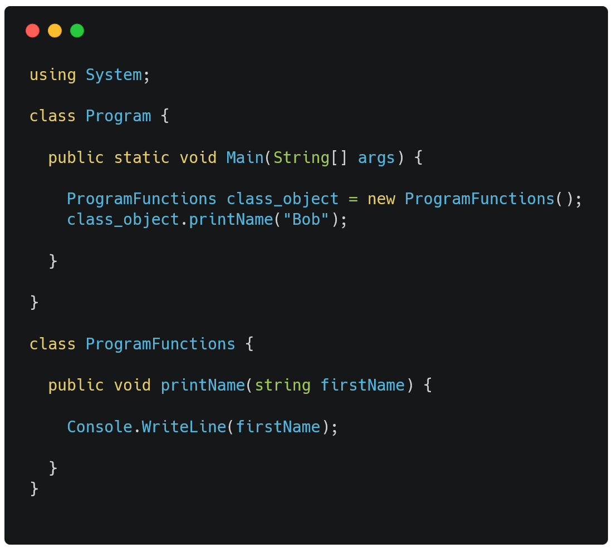
C# File Structure
C# makes use of Classes within it's file structure.
This means that every variable initialized or Function declared will be inside a Class.
Singular or multiple Classes can be within a single file.
Classes are defined with the keyword Class and surround all pieces of code inside, between two curly braces {}.

Slide 70
Whew! I bet that seems like a lot of information. Those are the basics of C#, which you'll need to be able to reference to fix the broken code!

Slide 72
CarUserControl.CS
Now that you know some C#, you're going to put it to use to fix CarUserControl.
We will create:
Several variables to store and access values
Instantiate an object to reference another script
Access the Unity API
Write 2 Void type functions
Call methods from other scripts

Slide 73
CarController Object
To access functions from one Script inside another Script, we need to create an Instance of an object.
Instance is a term used in programming to describe the creation of an object, which represents another code Class.
Any object created will be able to call or access public functions and values of the Class it represents.
We need to create an instance of CarController for our CarUserControl file to be able to use those functions.

Slide 74
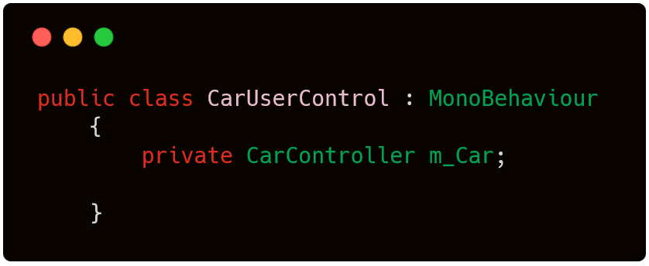
CarController Object
Inside CarUserControl.cs, create a variable at the top of the CarUserControl class.
The Type of our variable is the class we are creating an instance of, similar to using an Object as a type in Object Orientation code..
We only want the reference inside the script we’re currently coding, so private is suitable scope.

Slide 75
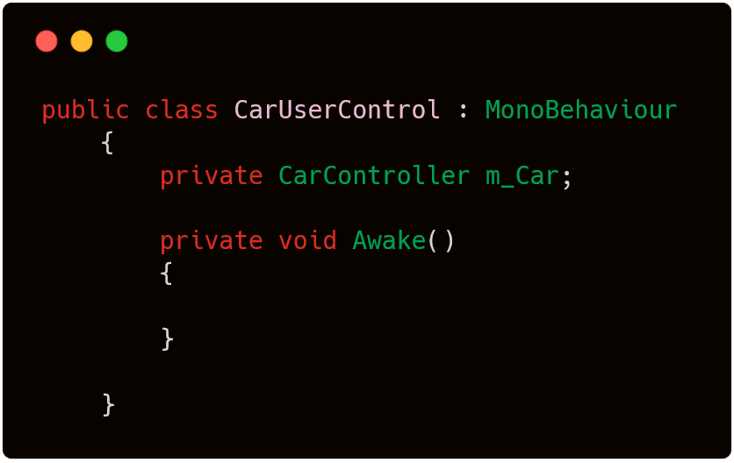
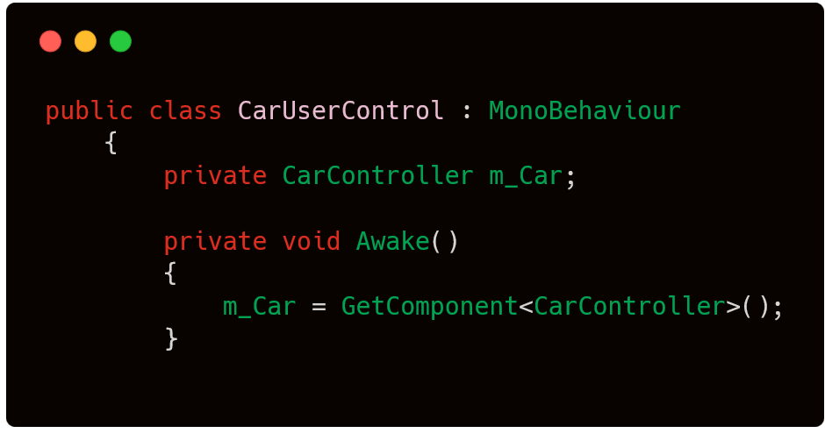
Who’s Awake(); ?
We’re going to use Awake() as a private void function
Using Awake() we can initialize m_Car, by executing the Unity function GetComponent<>().
Inside GetComponent<>() we will pass CarController as a generic parameter.
Awake() is another pre-defined function in Unity used to initialize variables and set up references between Scripts.

Slide 76
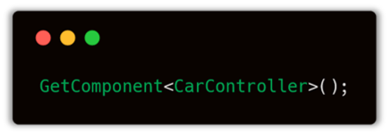
GetComponent<>
Why does this function use angle braces?
GetComponent takes the variable Type as the parameter.
The Type of that variable is a Script.
Functions using <> are known as generic functions in C#.

Slide 77


CarUserControl.CS
Now we will begin defining a void function called FixedUpdate().
We will also need to create two Float variables inside the function body. These will hold values that contain decimal points, so Float is appropriate.
FixedUpdate() is a predefined function inside the Unity application, meaning Unity already has set behaviour for handling this function.

Slide 78

CarUserControl.CS
We need to assign a value to our float variables. Using the Unity API we can assign an axis value to V.
Input is an interface created to interact with the Unity API.
When we use Input, it's possible to call every public function it provides. One being GetAxis();
The code written so far executes Input.GetAxis(“Vertical”) and assigns the return value to float v.
Find all Input functions @ https://docs.unity3d.com/ScriptReference/Input.html

Slide 79

CarUserControl.CS
We need to set the value for H in the exact same way as V.
We can use the exact same Input reference to complete another GetAxis() call.
The parameter we request this time is Horizontal, so both v and h are set with their respective values.
The new line written executes Input.GetAxis(“Horizontal”) and assigns the return value to float h.

Slide 80
What does that code do?
Horizontal and Vertical are axis values.
They define our input as going forwards/backwards or left/right.
By accessing them from the Unity API, we can tell if a user is pressing a key that should make our car go forwards, backwards or make a turn.
The Unity Input Manager is where input axis and game actions are defined.
This is what our GetAxis() performs for us.

Slide 81

Project Settings
The code makes requests to the Unity API. But we haven't set the Input values for the API to be listening for.
We need to access the Input Manager, to select certain Keys to control our game as they're pressed.
Input Manager Path:
Edit > Project Settings > Input>Axes>Vertical

Slide 82
Project Settings
The values we need to set are the positive and negative values:
Negative Button
Positive Button
Alt Negative Button
Alt Positive Button
Within the vertical menu setting
Positive will accelerate the car.
Negative will allow the car to reverse.
Within the Horizontal menu setting
Positive will turn one direction.
Negative will turn the other direction.

Slide 83
Project Settings
By setting the Alt Negative/Alt Positive input fields, we can input characters that will control our vehicle.
Let's set:
down as Negative
up as Positive
s as Alt Negative
w as Alt Positive

Slide 84
Project Settings
We have set the Vertical input, now the Horizontal values need to applied too.
Let's also set:
left as Negative
d as Positive
a as Alt Negative
right as Alt Positive

Slide 85

Project Settings
Despite the Name being Jump, this input will represent the vehicle handbrake.
Our Positive Button value is set to space, which is our keyboard spacebar.
Two keys were set for Vertical and Horizontal values because the car is able to move forwards, backwards, left and right.
This function has no alternate input, so only one key is needed to control this.
Input Manager Path:
Edit > Project Settings > Input>Axes>Jump

Slide 86

CarController.CS
CarController.cs is the file we use to create our object m_Car.
Inside CarController.cs there is a function named Move() on Line 129.
It is responsible for moving our Car. If we open it in our editor, we can see:
It is a complex function
It relies on many other functions
It requires 4 float parameters

Slide 87
Preprocessor Directives
In the C# language, code statements found with a # (hashtag) at the beginning of a line are known as preprocessor directives.
These are boolean statements that can be used to include or exclude blocks of code from the application when the code executes.
There are many directives C# supports that provide different functionality to the language.
#if
#else
#endif
#define
#undef
#warning
Full list of C# pre-processor directives @ https://docs.microsoft.com/en-us/dotnet/csharp/language-reference/preprocessor-directives/

Slide 88

Preprocessor Directives
Unity is able to use directives for platform dependent compilation.
This lets developers split scripts up into sections and compile areas of code exclusively for one supported platform.
The code is executed within the Unity Editor, this allows the code to compile specifically for any selected platform.

Slide 89

#if, #else and #endif
The use of Preprocessor Directives in this script is to check if the platform is or isn’t mobile. Since the game makes use of a keyboard spacebar, we make sure that the key input can be assigned to a value.
Back in CarUserControl.CS, we're going to update the two lines we wrote previously by adding CrossPlatformInputManager to each line.

Slide 90

#if, #else and #endif
The use of Preprocessor Directives in this script is to check if the platform is or isn’t mobile. Since the game makes use of a keyboard spacebar, we make sure that the key input can be assigned to a value.
Now we declare an #if at the very beginning of the line. The #if condition will be !MOBILE_INPUT meaning not mobile input.

Slide 91

#if, #else and #endif
Inside the #if statement scope, we need to initialise the float value handbrake.
We can do this the exact same as before, but using the variable name handbrake, and the GetAxis() parameter value “Jump”.
The code within this #if block will only execute if the platform is not recognized as mobile by Unity.
The float value should look like this
Float handbrake = CrossPlatformInputManager.GetAxis(“Jump”);

Slide 92
Call Move();
Awake() will create a reference to the CarController script when it is executed.
We can use our m_Car object to call public functions inside CarController.cs.
Function calls have a typical structure:
<object> <dot> <function name> <parenthesis; parameters>

Slide 93

Call Move();
Let’s call the Move() function from the CarUserControl script. Move() is responsible for moving the car models in the game.
Inside our #if directive, after we initialise the handbrake variable, we will type our object m_Car.
Then separated by a dot . we can type the name of the function we want.
The m_Car object is calling a public function from the CarController script.

Slide 94

m_Car.Move();
We saw previously that Move() has 4 parameters that we have to pass as arguments.
steering
acceleration
footbreak
handbreak

Slide 95
Parameters [1], [2], [3]
The GetAxis() API call assigns keyboard input to our variables h and v.
Steering
The horizontal input will control steering.
The horizontal axis values will control the cars horizontal angle, moving forwards.
Acceleration
Vertical input will provide an acceleration value.
The vertical axis value will represent forwards and backwards motions.

Slide 96

Parameters [1], [2], [3]
Inside the Move() parameters, we need to pass our variables separated by a comma.
h is passed as the steering value.
v is passed as the acceleration value.
v is also passed again, as the footbrake value.
Our function call should now look like:
m_Car.Move(h, v ,v , );

Slide 97

Parameters [4]
The fourth parameter is required for handbrake control of the Car model.
The handbrake variable declared above this function call is passed as the fourth parameter.

Slide 98

#else
Using the m_Car object, we will call Move() again but inside the #else directive in case handbrake is never initialised.
The parameters will be exactly the same except for handbrake.
This is because they were declared outside of the #if directives scope.

Slide 99

#else
The next m_Car.Move() call will be inside the scope of our #else directive.
Here we will pass through a value of 0f. This will meet the criteria for passing a float value but also leave the handbrake functionless, as no value is actually being passed.

Slide 100

#endif
Anytime a condition directive uses #if, it needs to eventually be closed with #endif.
If you don’t close the #if, then the scope will encompasses code you don’t may not want inside that scope.
This will complete our FixedUpdate() function!

Slide 101

Final Script
Including the code that was already inside CarUserControls.cs already, our script should now look like this.

Slide 102
Test Run!
When anybody writes code, they can make errors and run into problems. One way of countering this issue is by running our code, at incremental stages to see if it executes!
If the game runs, great! We’re making progress.
If the code has an error, Unity will show a message at the bottom of the Unity window!

Slide 103
Let's test your game!

Slide 104
Whoa what’s wrong?
A few parts of the app aren't working properly. You're going to fix them!
Problem II:
You can drive through WALLS. WHAT.

Slide 106
Colliders
When two objects meet in a game, you might not want them to pass through each other. They need to have a physical presence in the game. Unity makes use of colliders for this.
Colliders can
Define the shape of an object for collision detection.
Do not have the be the exact same shape as the model they are covering. Often a 3D model will be covered in colliders of all types of shapes!
Unity can make use of Static colliders and Rigidbody colliders.

Slide 107

Colliders
If we left click the road, it will become outlined in red, showing the scale of the 3D object in the scene.
Left clicking an object inside the scene, will bring up details inside the Inspector tab.
You can do this for any object available in the scene.

Slide 108

Colliders
The Inspector tab provides us with the object name 'loftedSurface1'.
It also indicates it has a Mesh Collider, to make it a solid 3D object in the scene.
To see the difference this makes, try running the game with the Mesh Collider box ticked and then unticked.

Slide 109
Applying Colliders
Inspecting the walls to either side of the road shows that they have no colliders applied. Other moving objects like the Car would simply pass through them!
We currently know that neither wall around the track has colliders. This means:
If either car drives into them we pass through completely
The cars can’t get back onto the track, because the road is a solid object, floating above the scene floor.
To fix this we are going to apply colliders to the necessary objects!

Slide 110

Mesh Colliders
Let’s begin by clicking a wall object in our scene
Immediately the details in our Inspector tab change.
The wall is called loftedSurfaceX where X is a number 2 or 3.
It also has 2 components already applied, a Mesh Filter and Mesh Renderer.

Slide 111
Mesh Colliders
What are these components?
A Mesh is a series of triangles that compose the 3D shapes we see in Unity Scenes.
It’s possible to take this data and apply textures or colors to the faces of triangles in a Mesh.
A Mesh Renderer component, such as the one in our Inspector, visually renderers the object in a Unity scene.

Slide 112


Applying Mesh Colliders
When we select a scene object, our Inspector will show a button saying Add Component.
Add Component will load a new menu, this will provide access to the Physics submenu.
It is within Physics, that we find Mesh Collider.

Slide 113
Applying a Mesh Colliders
Great! Now what do I do about the other wall?
We can follow the same practise to apply a Mesh Collider to that wall too!
Select the object in scene, navigate the Add Component menu
Add Component > Physics > Mesh Collider
Then let’s take this game for a Test Run!

Slide 114
Test Run!
Now we have made another set of changes to the game, we should have a test run to see how they affect the game!
If our Mesh Colliders have been applied incorrectly, we won’t receive an error message. We will just continue to pass through the scenery until we fix the issue!

Slide 115
Let's build your game and try it!

Slide 116
What do you mean Build?
When we develop and modify games in Unity, eventually we might want to run it outside of the Unity Editor as a standalone app.
We are able to do this in Unity via the Build Settings.
Here you are able to see every platform available to publish your game on. We are going to create a standalone for a desktop.
We can build and export our game for multiple platforms using this menu in Unity.

Slide 117

Publishing Builds
Access the Build menu by going ‘File > Build Settings’.
Try choosing ‘Pc, Mac & Linux Standalone’ in the platform selection.
Select ‘Build’ at the bottom of the window, a new window will open up to select where to save the build of the game.
You now have an executable of this project! Try run it on your machine!

Slide 119
What did you learn today?
We created a fun quiz to test your knowledge and see what you learned from this workshop.
http://mlhlocal.host/quiz
Notes:
What to Say:
Read the slide.
What to Do:
Get participants excited about taking the quiz. Encourage them all to take it, and pass out stickers to participants who earn 100s. Also encourage participants to take the survey - let them know that Localhost takes their feedback very seriously and we use their feedback to make the workshop better for future participants.

Slide 120
Where to go from here...
Visit mlhlocal.host/unity-learn to learn more
1
2
Join the discussion at mlhlocal.host/unity-connect
3
Learn about Unity Hub - a new tool to make learning and collaborating easier.
Notes:
What to Say:
Read the slide.
What to Do:
Let participants know that you're wrapping up.

Slide 121
Keep Learning: Practice Problems For Later
Extra Practice Problem 1:
Drag Asset models into the race track and add Mesh Filters + Colliders to them!
Extra Practice Problem 2:
Integrate actual AI into your game here:
Notes:
What to Say:
Read the slide.
What to Do:
Encourage participants to try these problems on their own.

Slide 122
Keep the Momentum Going!
Sign up to host this awesome workshop at https://localhost.mlh.io/
1
2
Running continuous workshops earns you points towards your Momentum Rewards
3
Redeem your Rewards Points for custom stickers, t-shirts, and pizza!
Notes:
What to Say:
Read the slide.
What to Do:
Let participants know that you're wrapping up.

Slide 123
v.0.0.1

